Slide 1
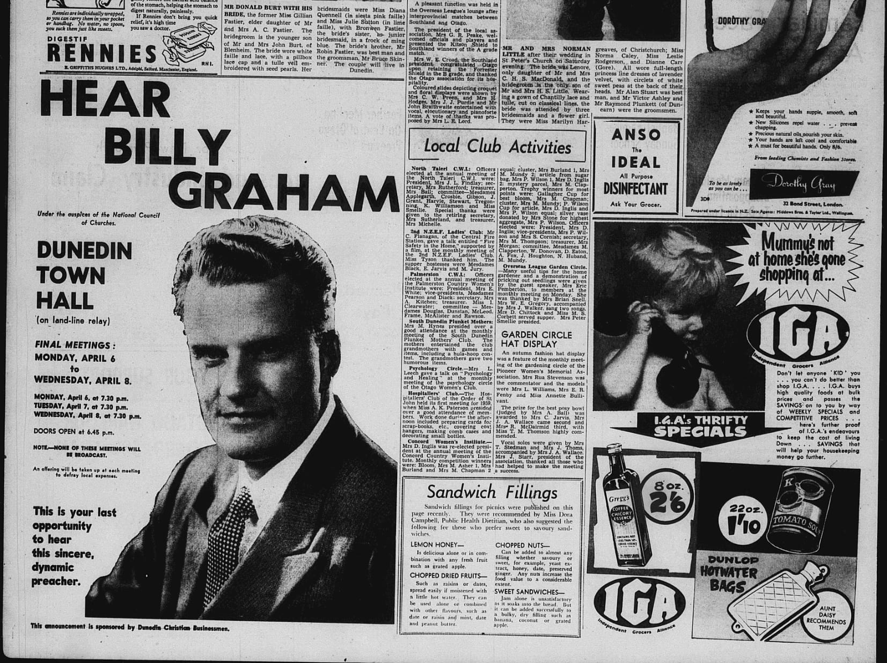
America’s Pastor and the ‘Satin Satan’
Politics and Celebrity in Billy Graham’s 1959 Crusade

Slide 2
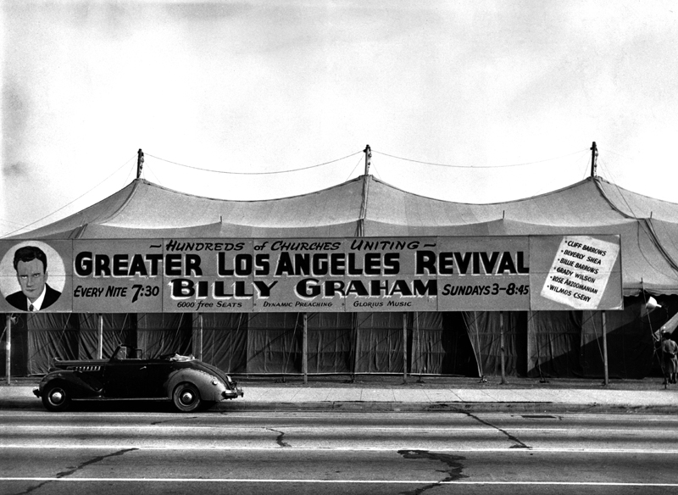
‘Canvas Cathedral’ Los Angeles, 1949.
Source: http://billygrahamlibrary.org/this-date-24sept1949/

Slide 3
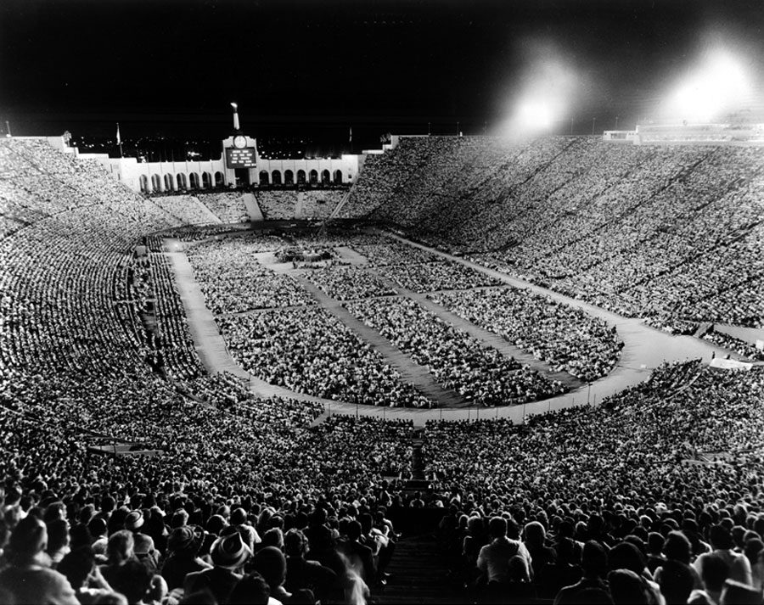
Los Angeles Crusade, 1963
Source: http://www2.wheaton.edu/bgc/archives/bulletin/bu1308.htm

Slide 4
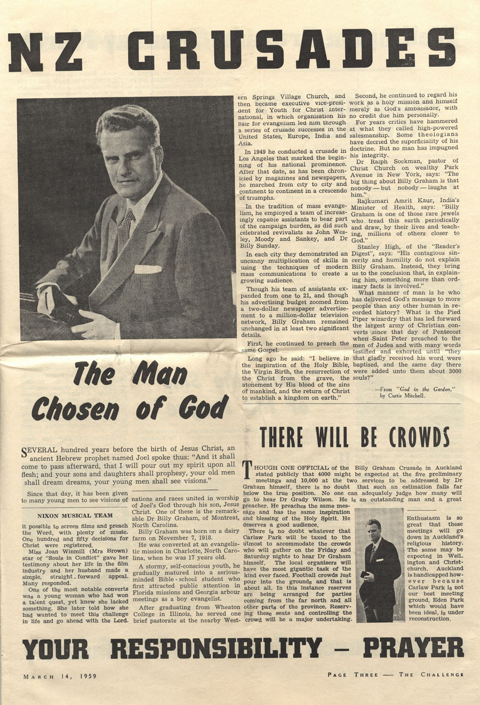
29th March – 10th April, 1959.
Venues: Carlaw Park, Auckland; Athletic Park, Wellington; Lancaster Park, Christchurch.
Source: http://www2.wheaton.edu/bgc/archives/docs/bgeanzaustralia59/Kiwinewsletter3.htm

Slide 5
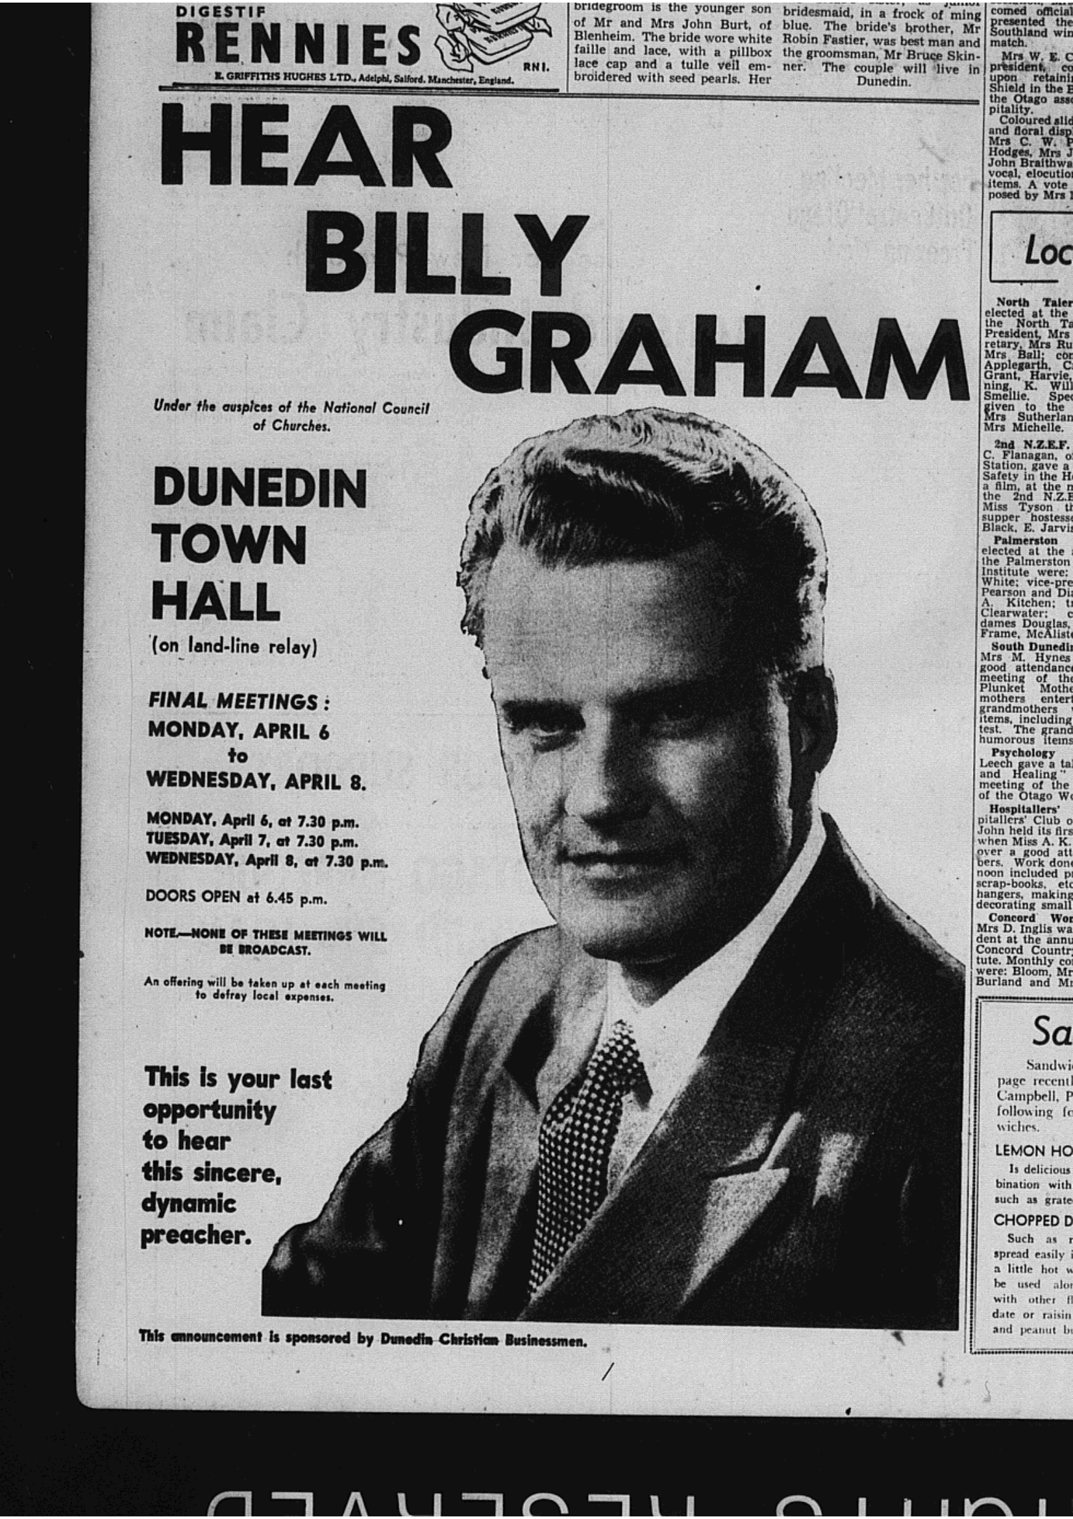
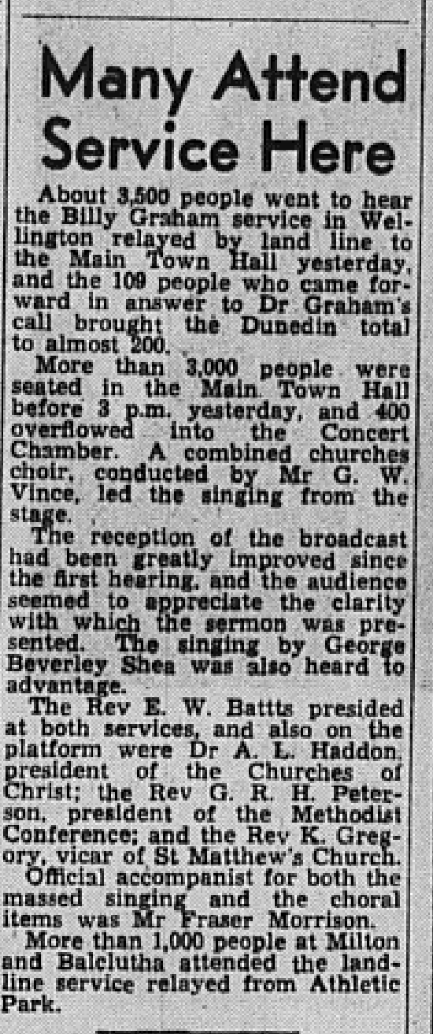
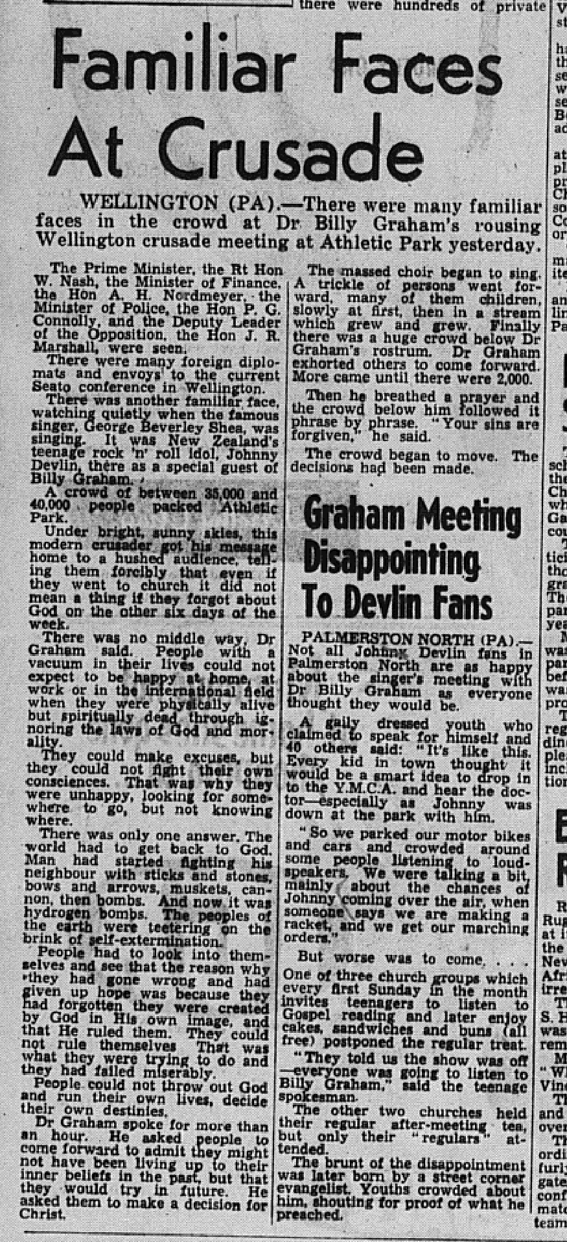
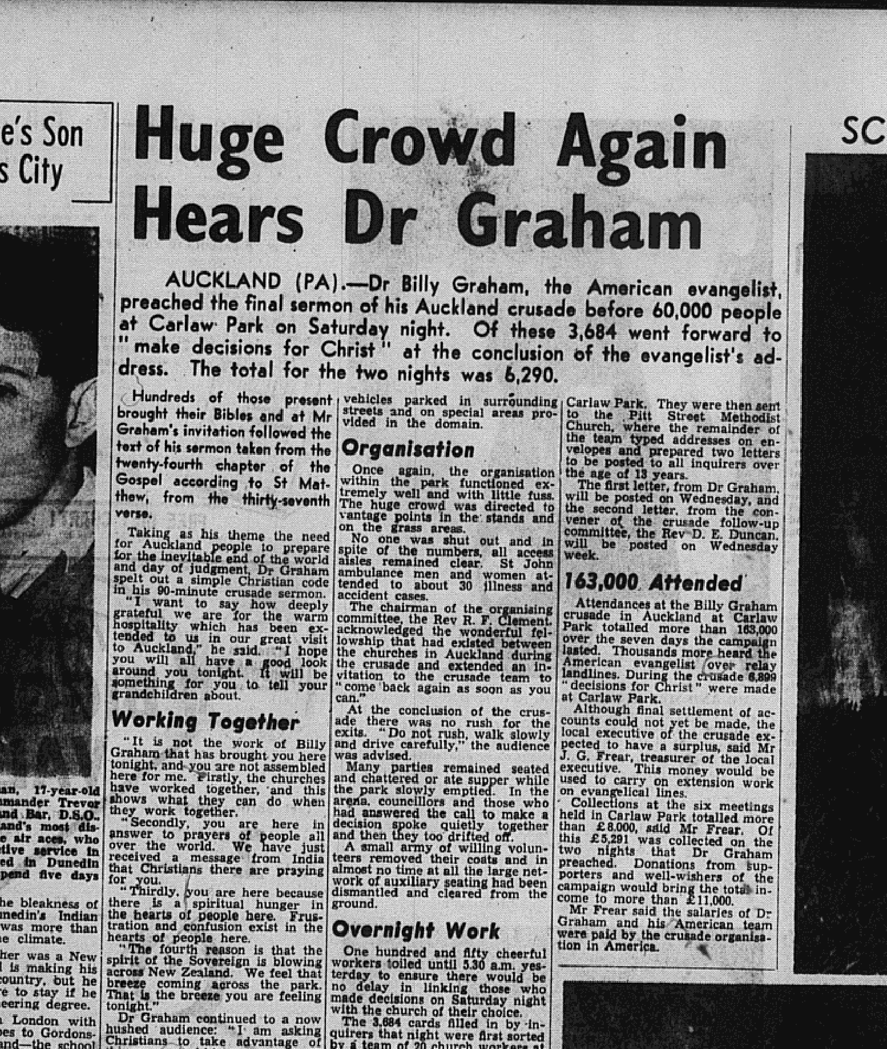
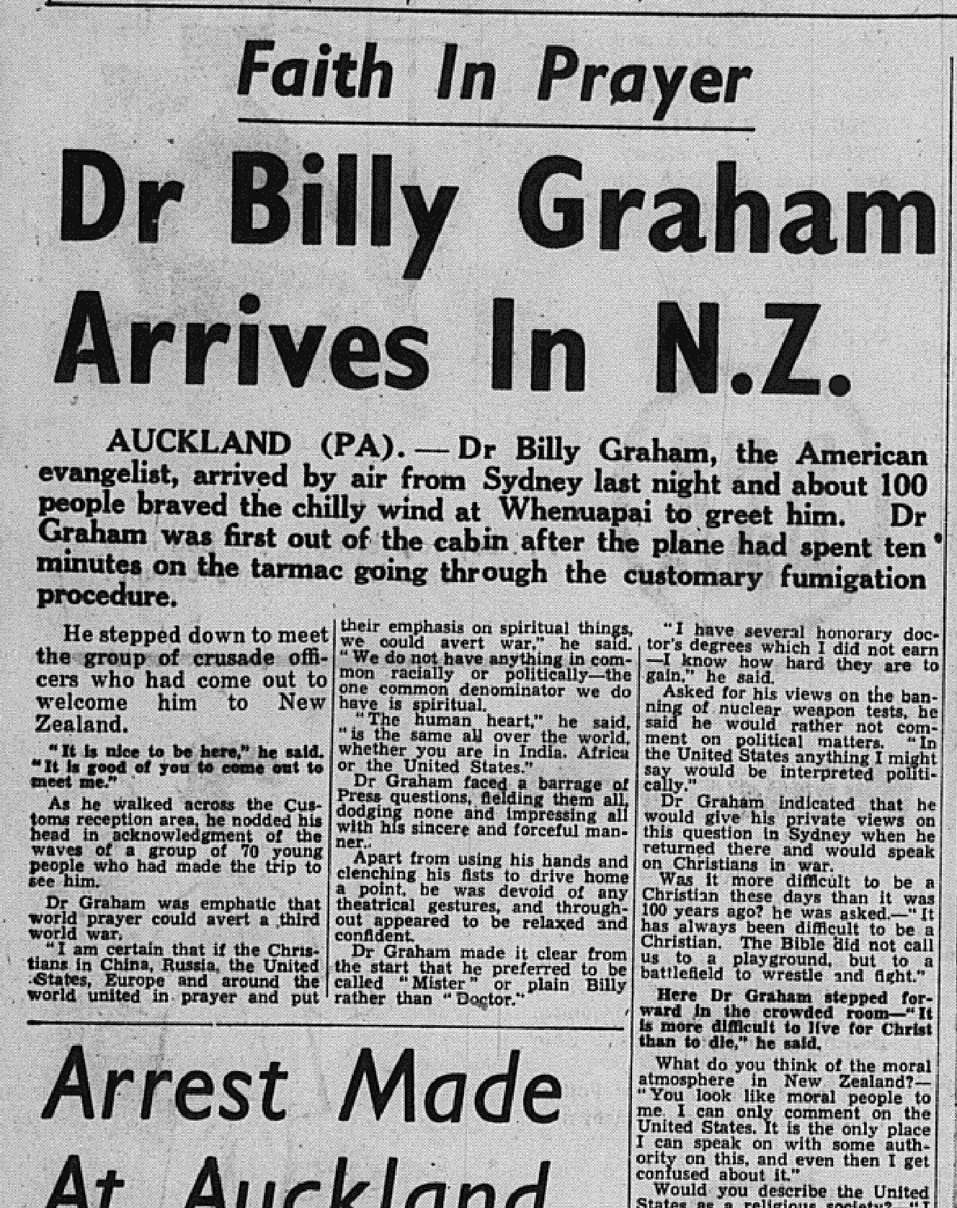
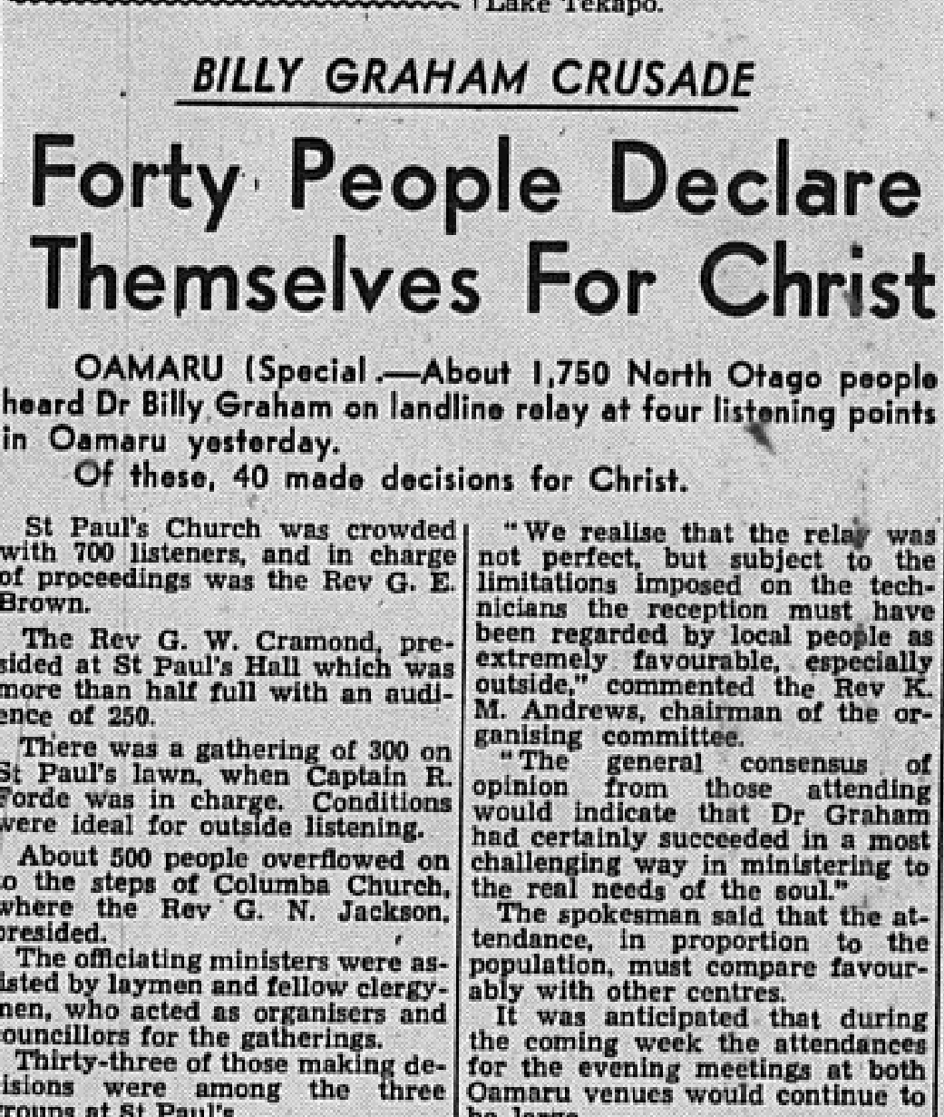
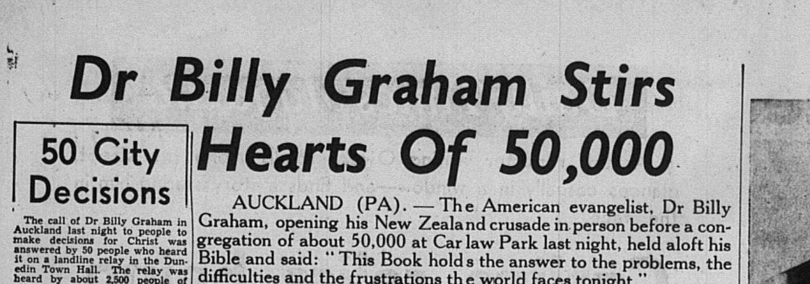
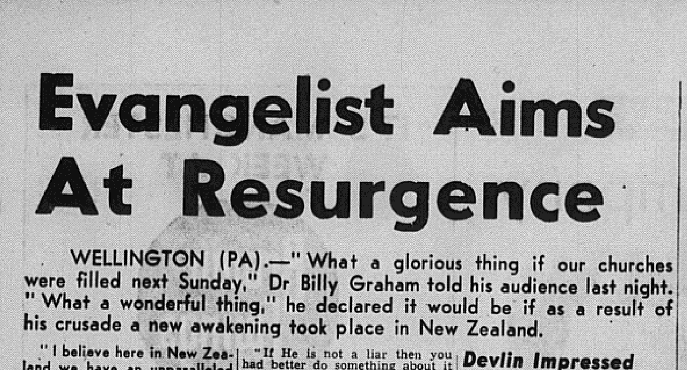
Source: Otago Daily Times, April 2nd – April 6th, 1959

Slide 6
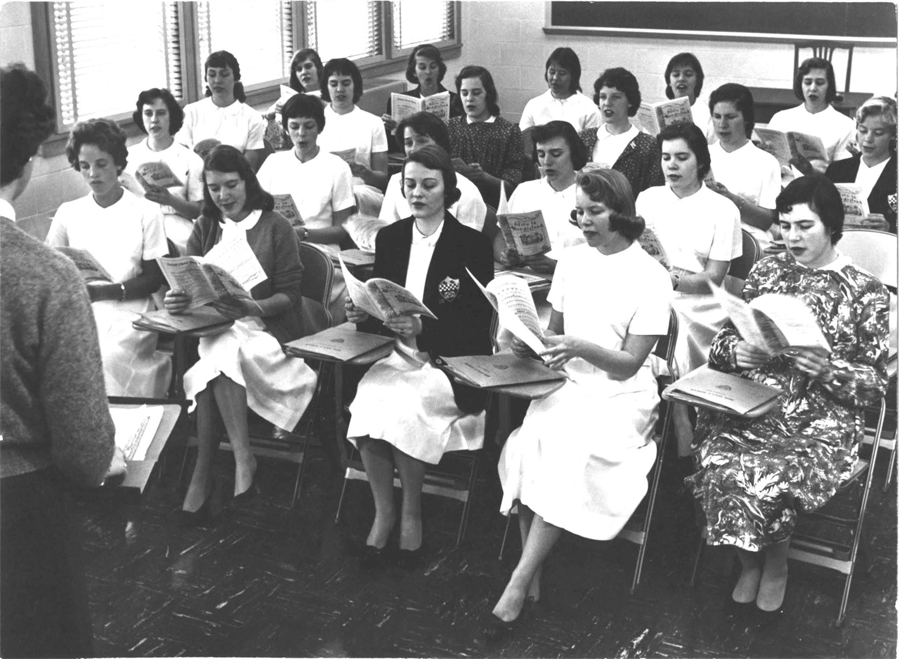
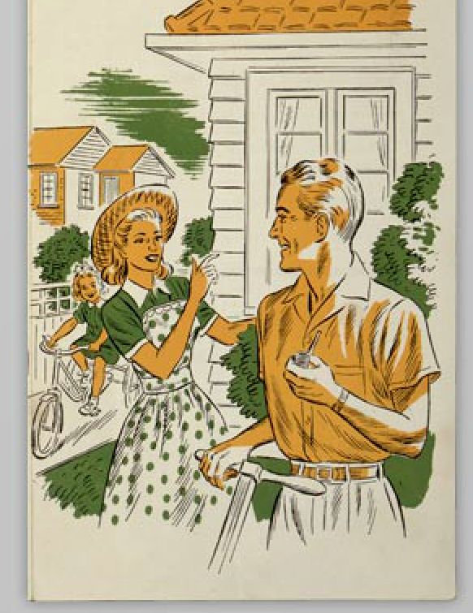
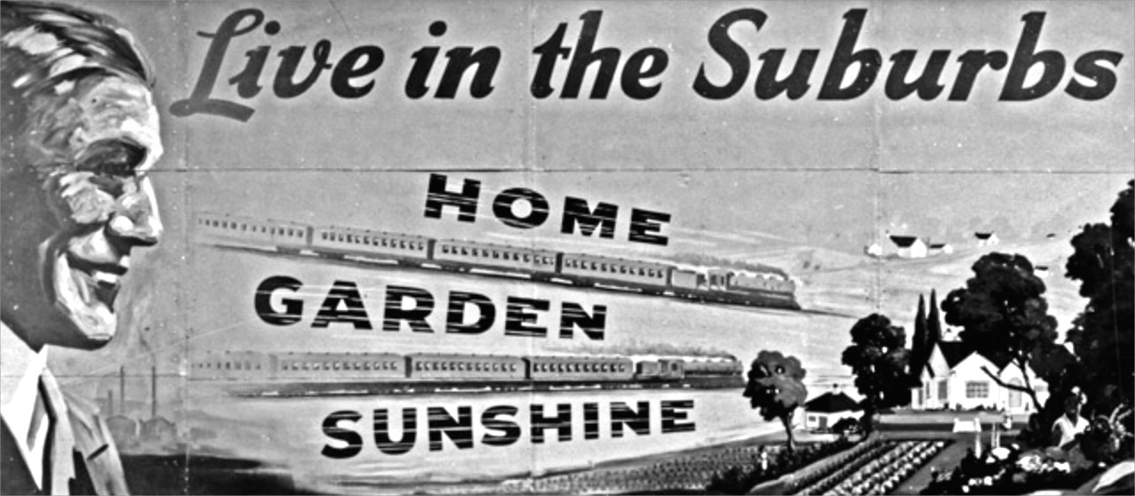
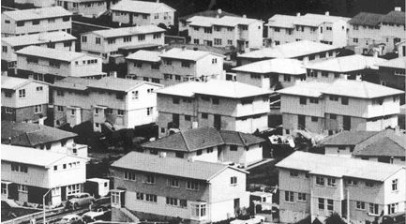

Slide 7
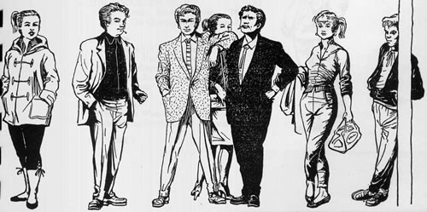
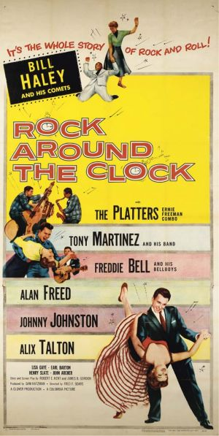
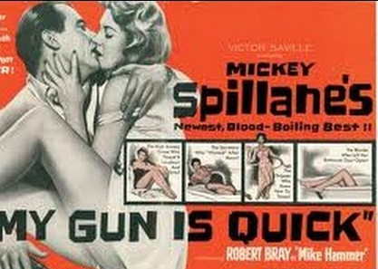

Slide 8
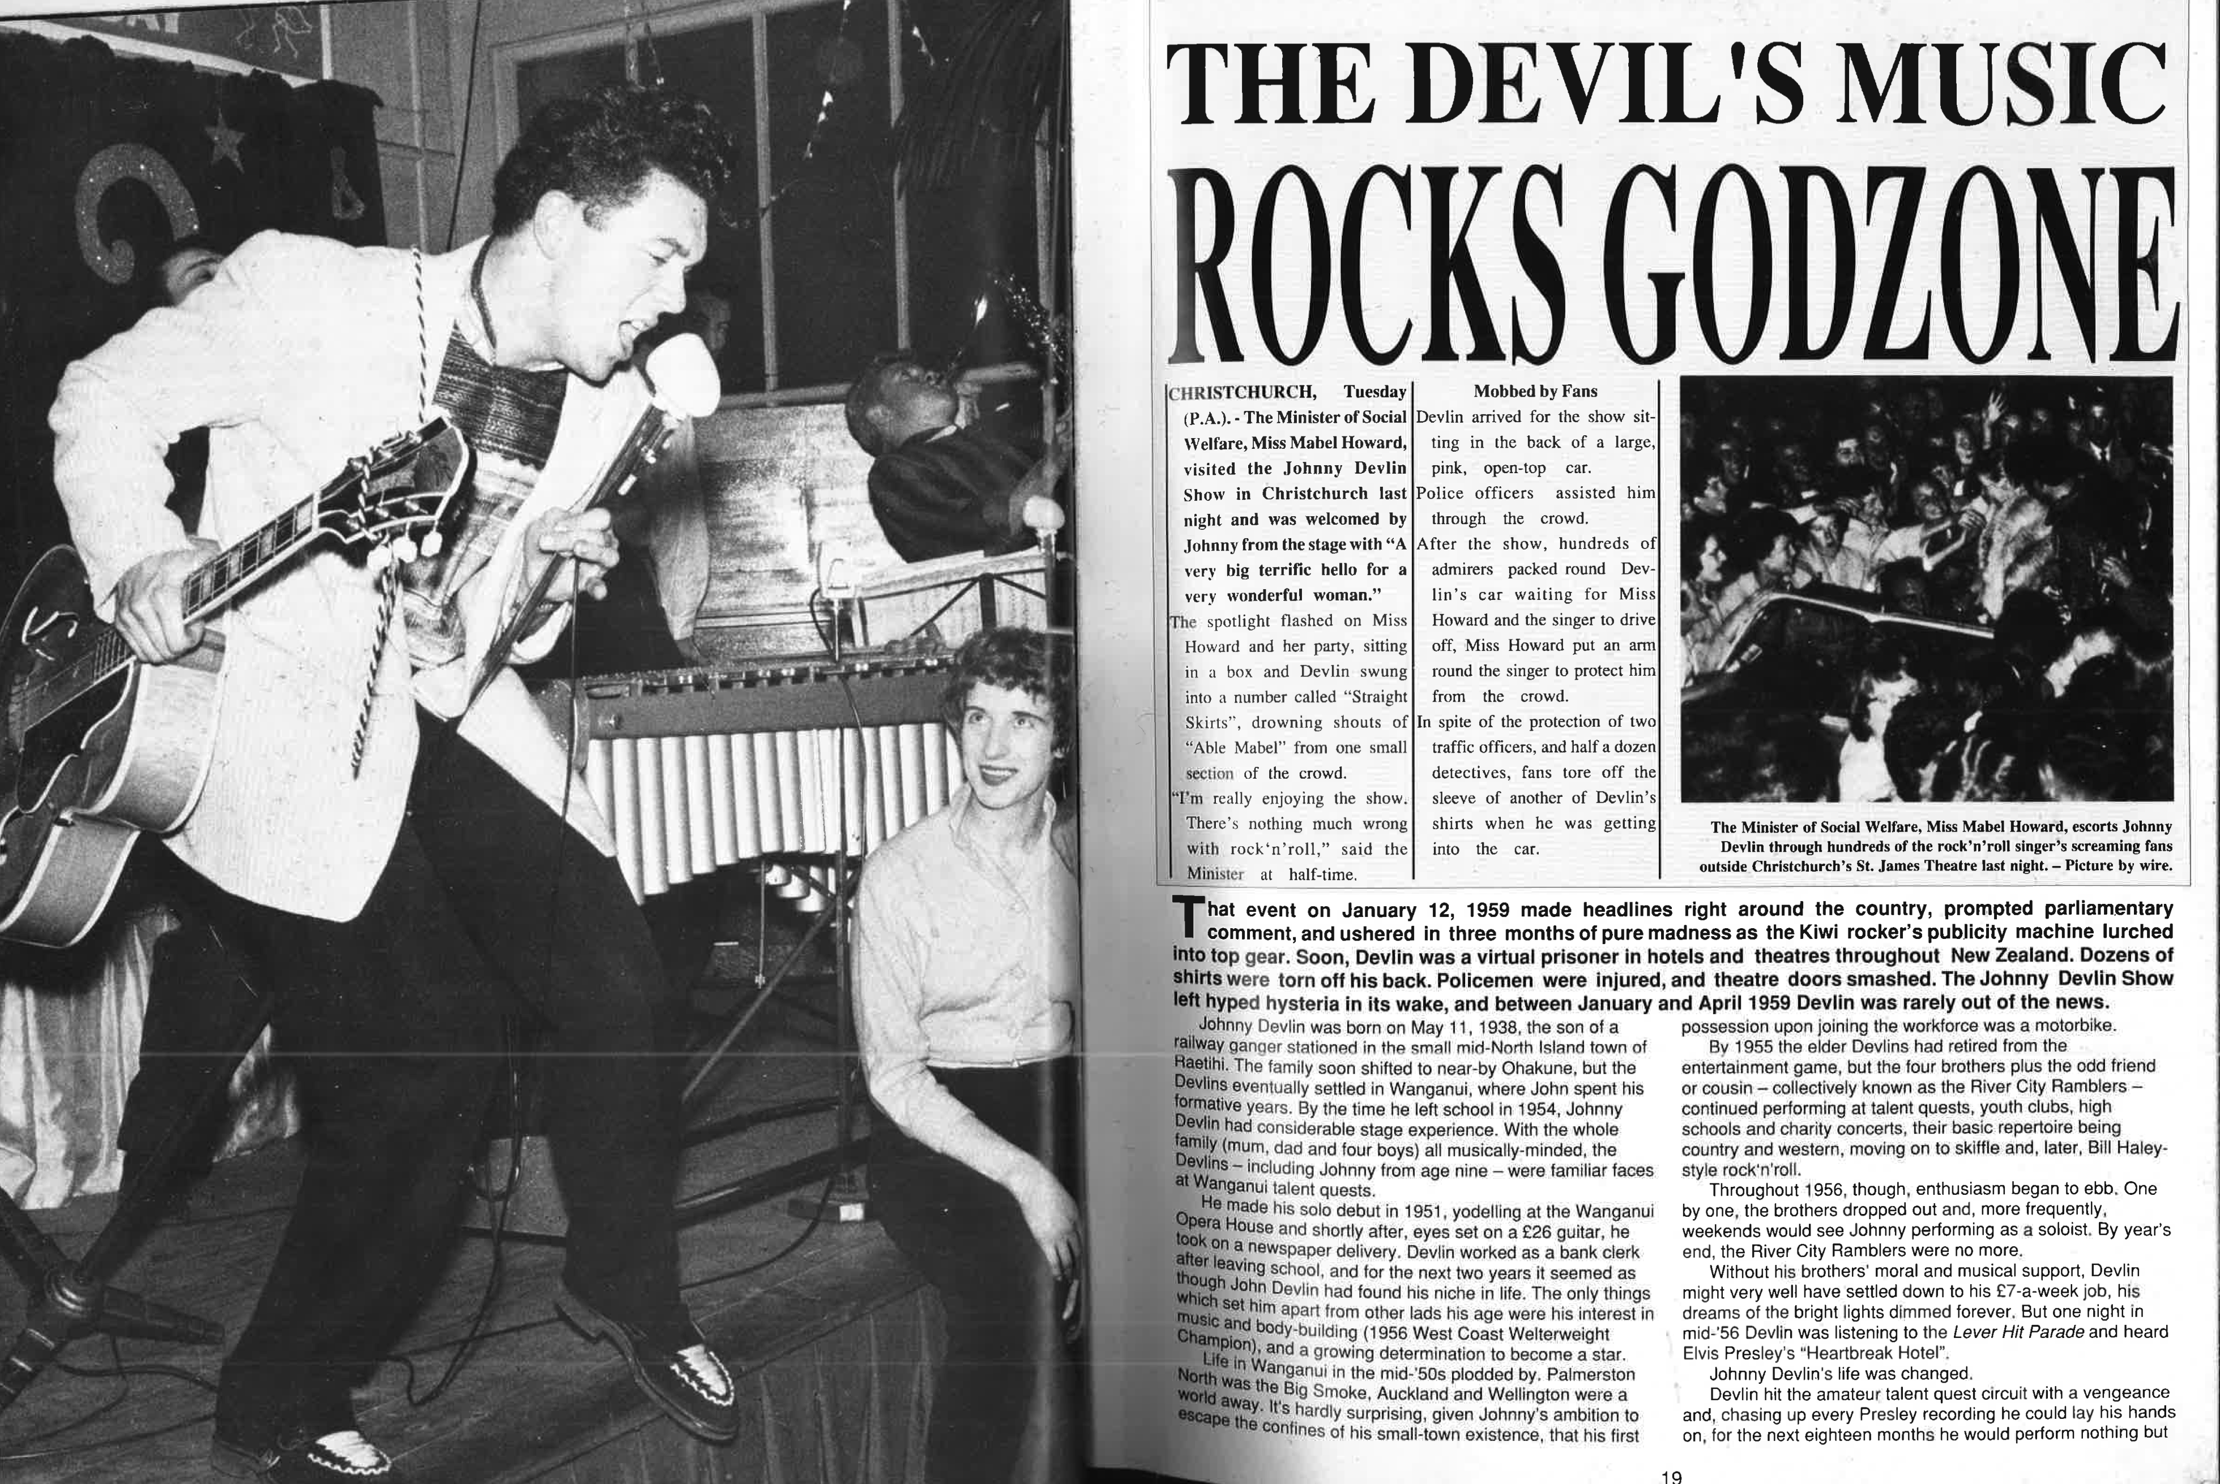
John Dix, Stranded in Paradise: New Zealand Rock ‘n’ Roll 1955-1988, (Wellington: Paradise Publications, 1988), p. 18 & 19.

Slide 9
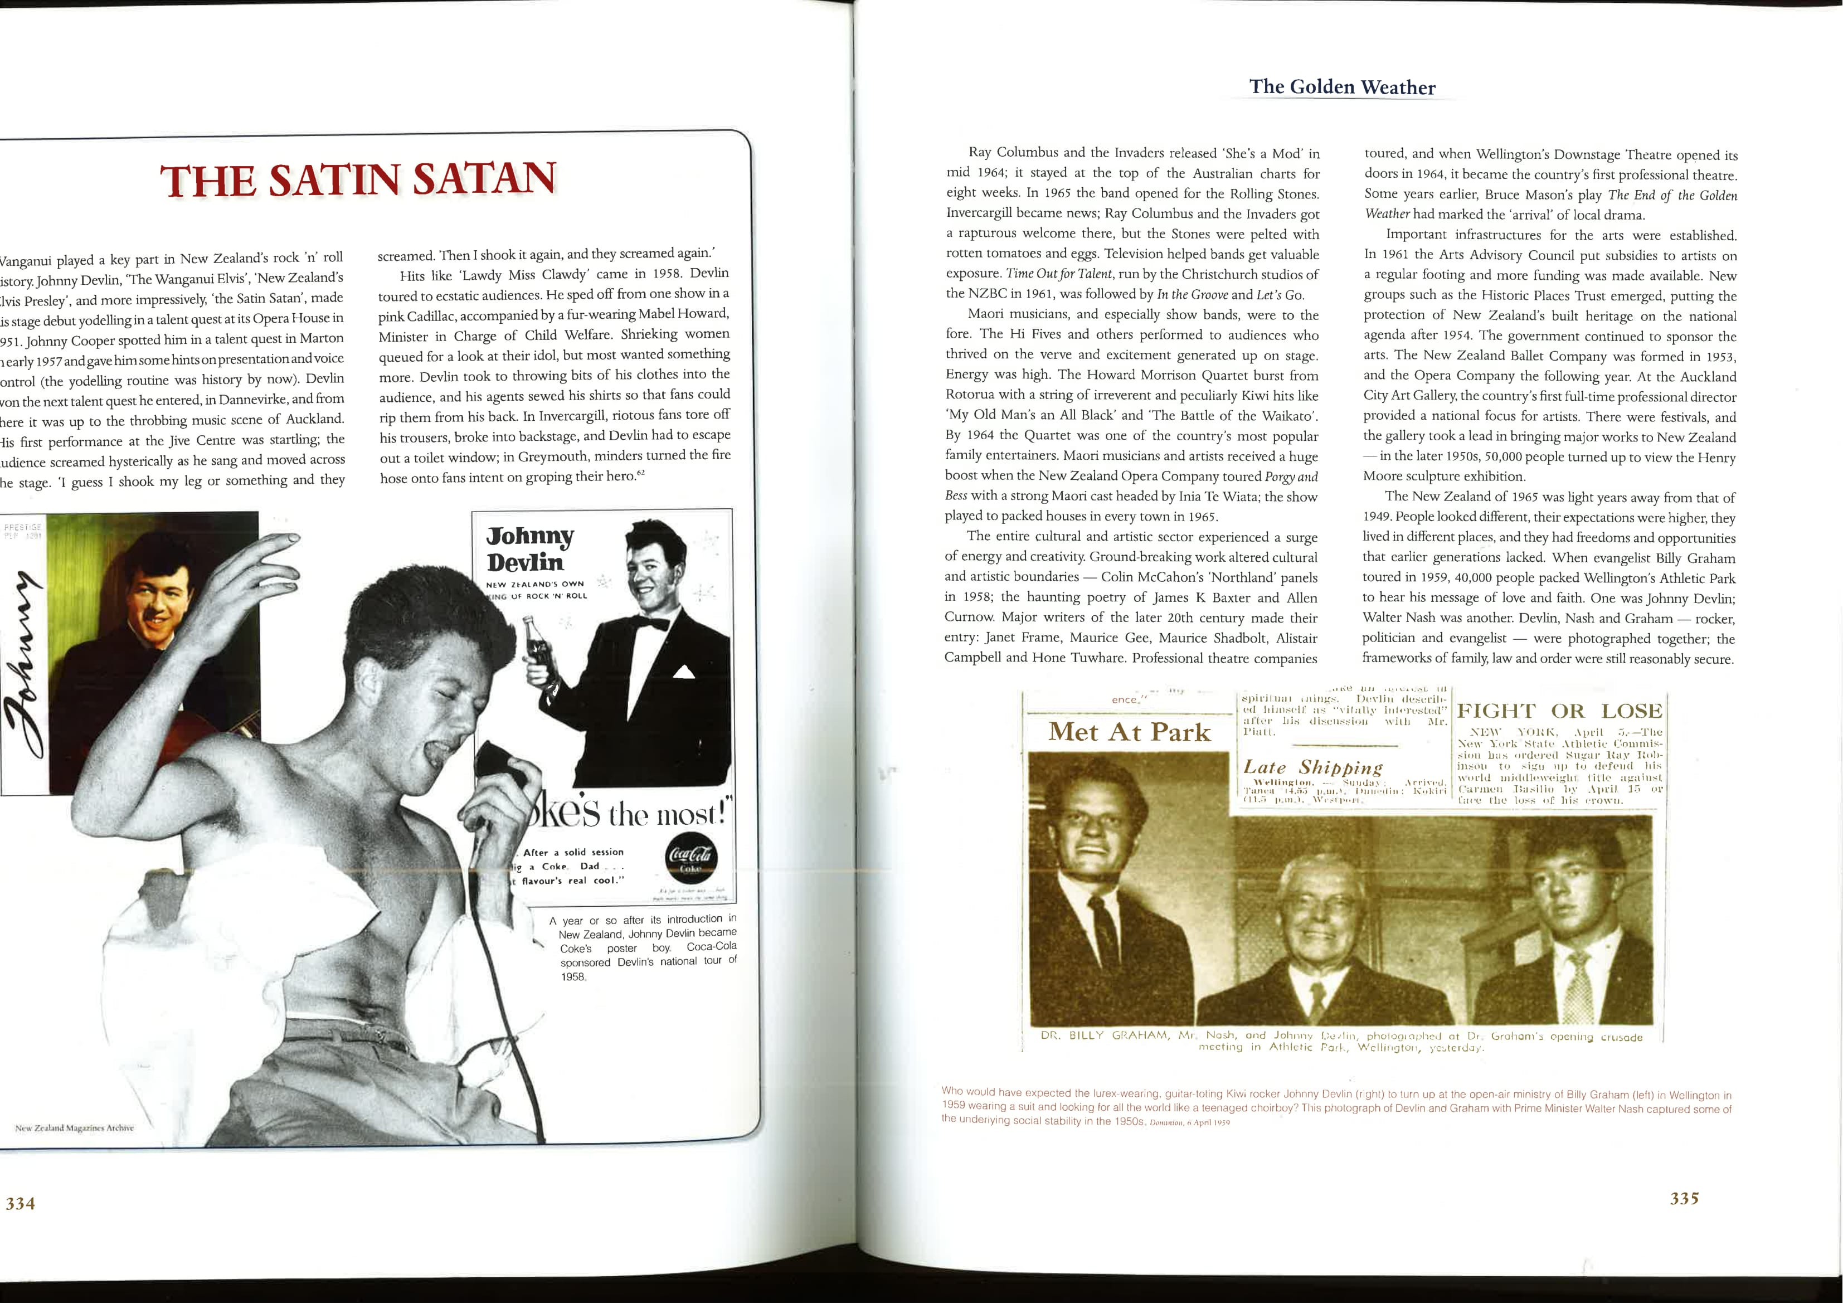
‘Dr Billy Graham, Mr. Nash and Johnny Devlin…’
Dominion, April 4th 1959, 4.

Slide 10
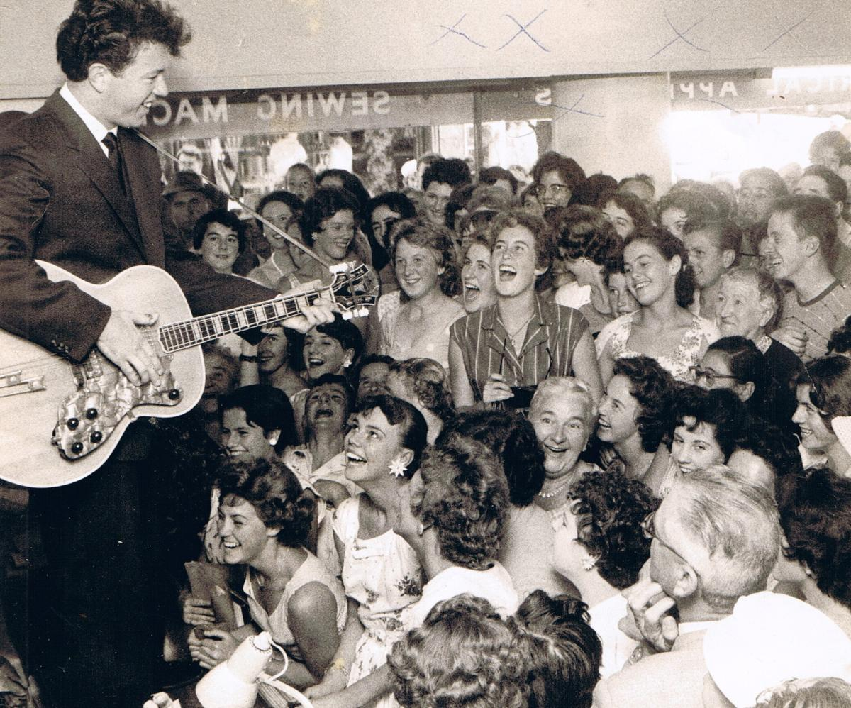
Johnny Devlin with fans, 1959
Source: http://theozhiztoryblog.blogspot.co.nz

Slide 11
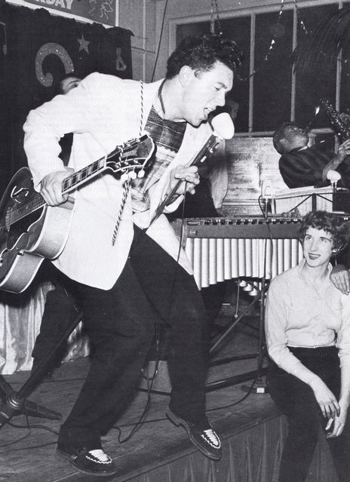
Source: Bronwyn Dalley, Frontier of Dreams: the Story of New Zealand, (Auckland: Hodder Moa Beckett, 2005) p. 210
Source: www.audioculture.co.nz

Slide 12
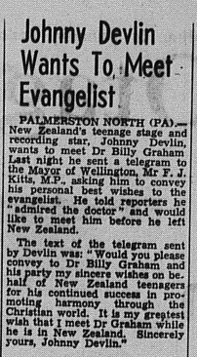
Source: the Otago Daily Times, April 3rd 1959, 2.

Slide 13
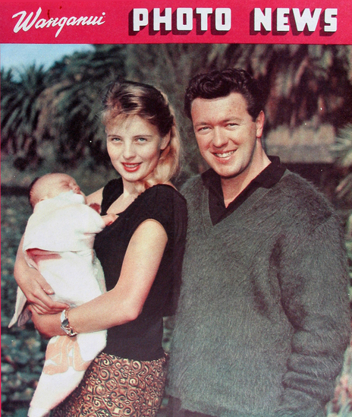
Source: Wanganui Photo News, 1963

Slide 14
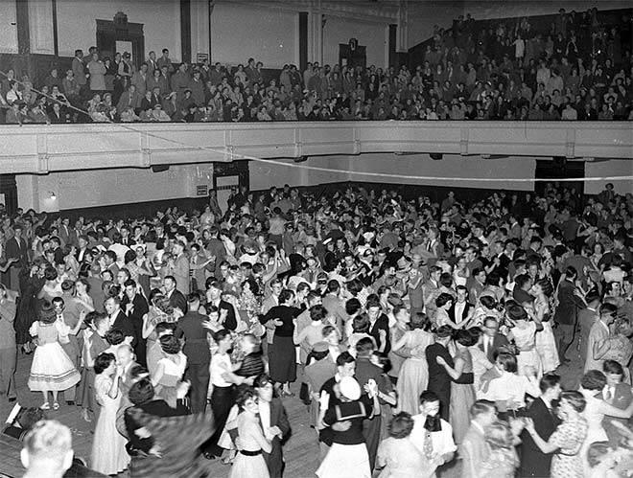
Saturday Night Dance, Dunedin 1959
Source: http://www.teara.govt.nz/

Slide 15
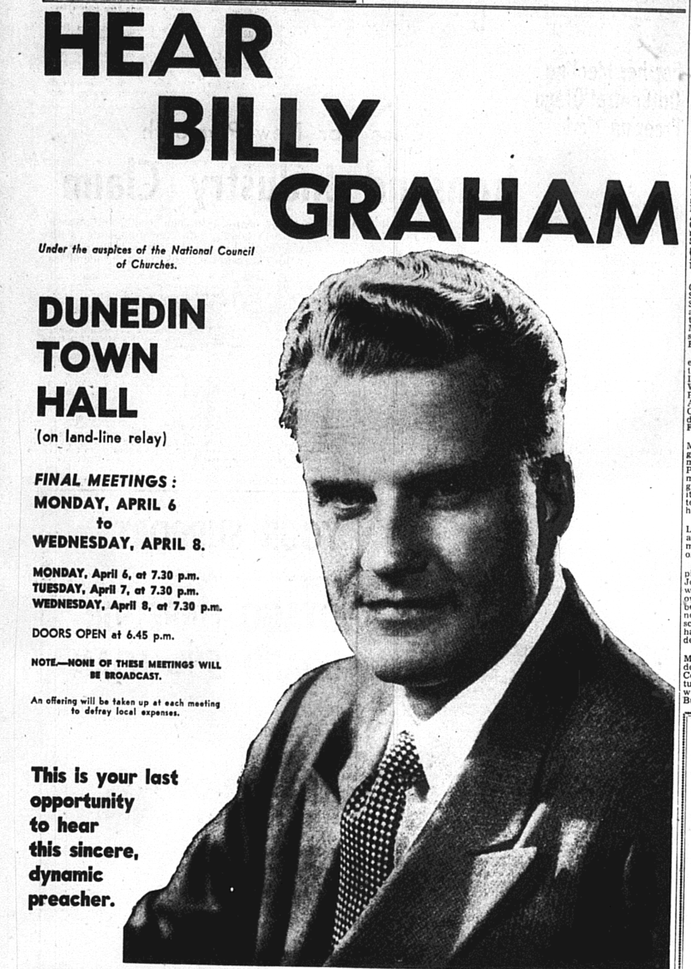
Source: the Otago Daily Times, April 2nd, 1959, 2.

Slide 16
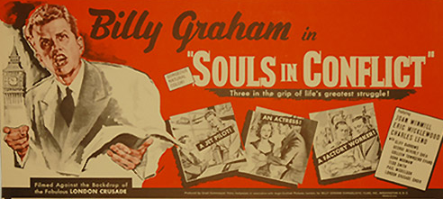

Silver Screen Evangelism, 1954 & 1955
Source: http://billygraham.org/worldwide-pictures/

Slide 17
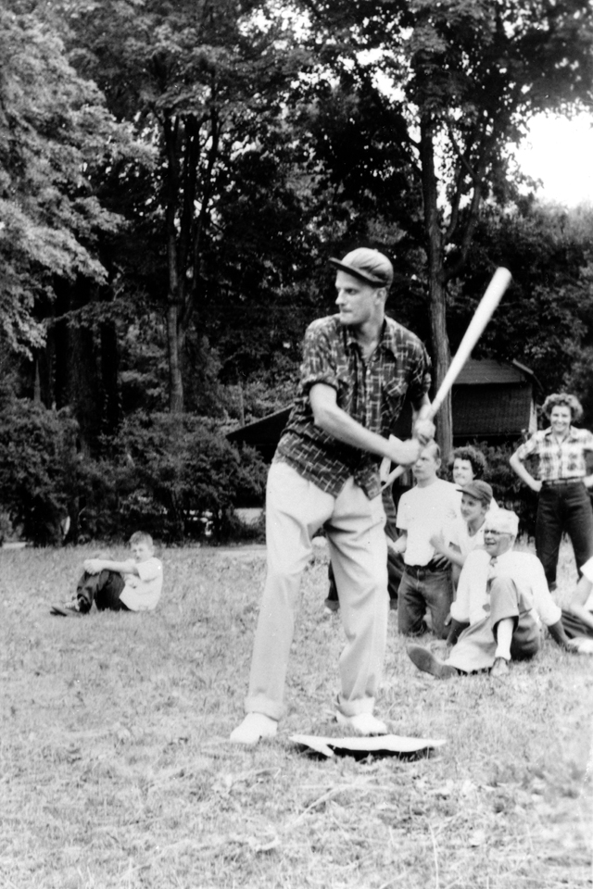
North Carolina, 1958
Source: https://www.billygraham.ca

Slide 18
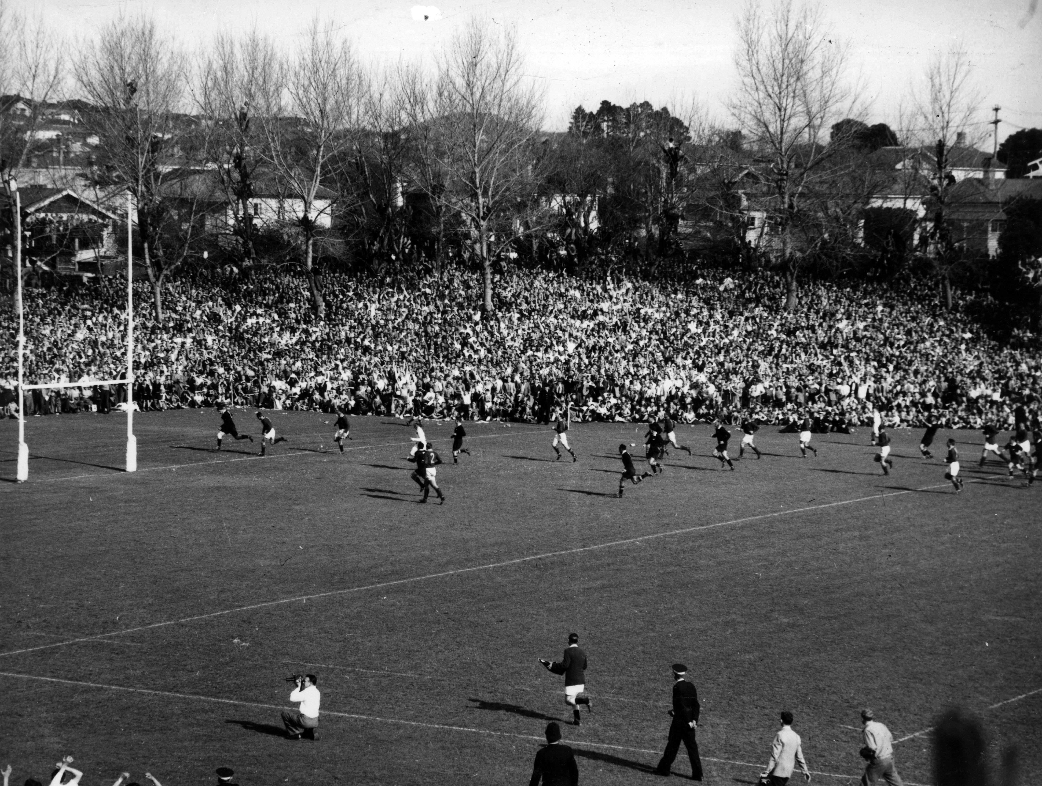
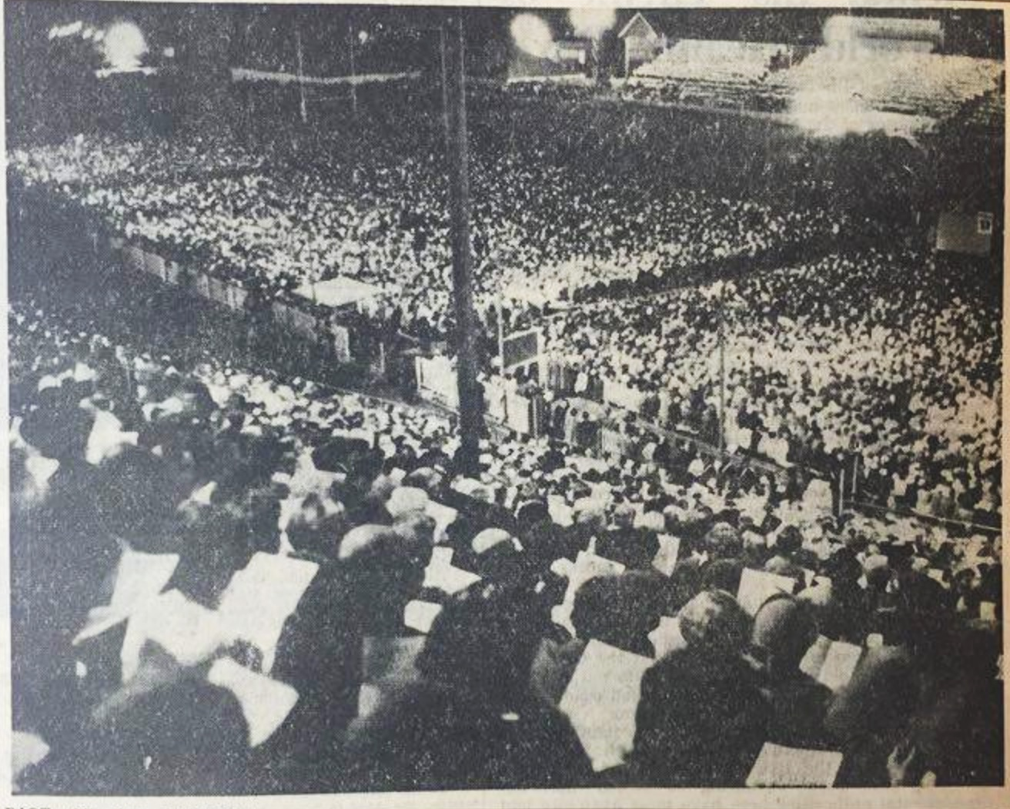
Springboks v. All Blacks, Carlaw Park
1956
Source: https://www.nzhistory.net.nz
Crusade Attendees, Carlaw Park 1959
Source: ODT 6th April, 1959, 5.

Slide 20
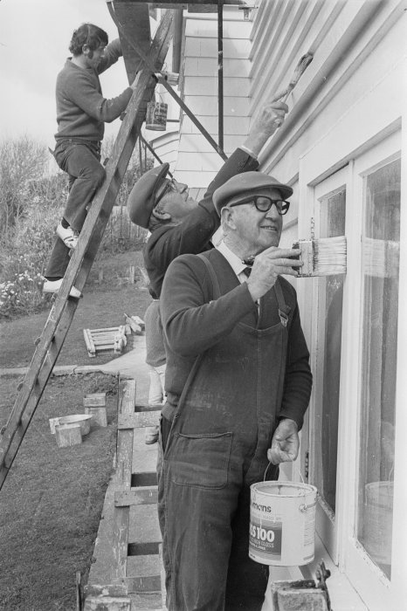
Arnold H. Nordmeyer painting the Presbyterian Manse, Lyall Bay, Wellington (1977)
Source: National Library of New Zealand, ref: EP/1977/2019/32-F

Slide 21
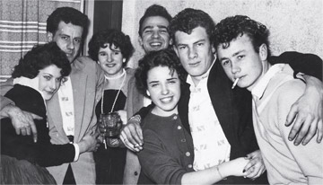
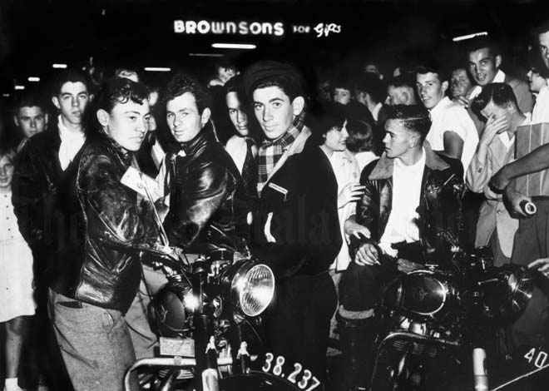
Bodgies & Widgies, Remuera 1955.
Source: http://www.listener.co.nz
Milkbar Cowboys, Queen St. Auckland, 1955.
Source: https://www.teara.govt.nz

Slide 22
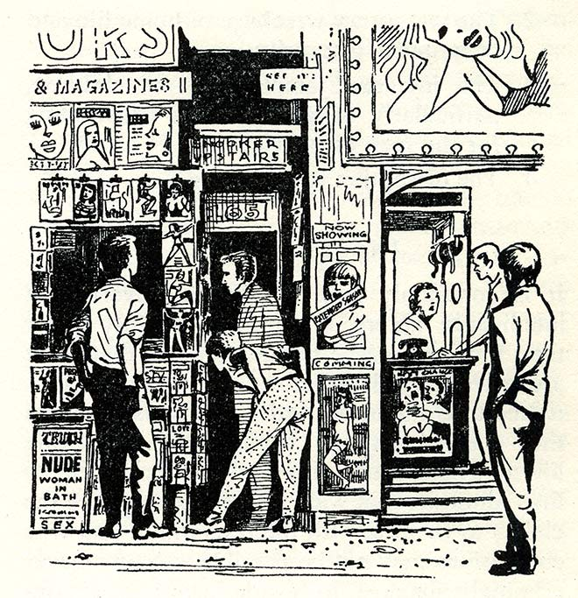
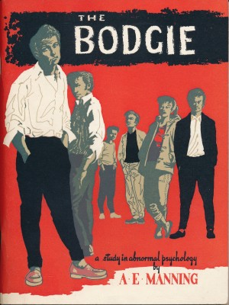
Arthur Edward Manning, The Bodgie: a Study in Abnormal Psychology (1958)

Slide 23
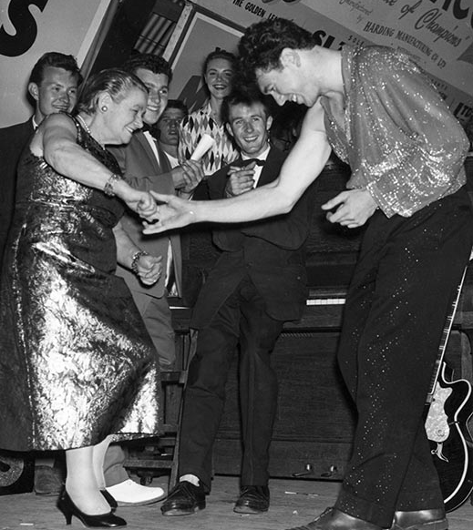
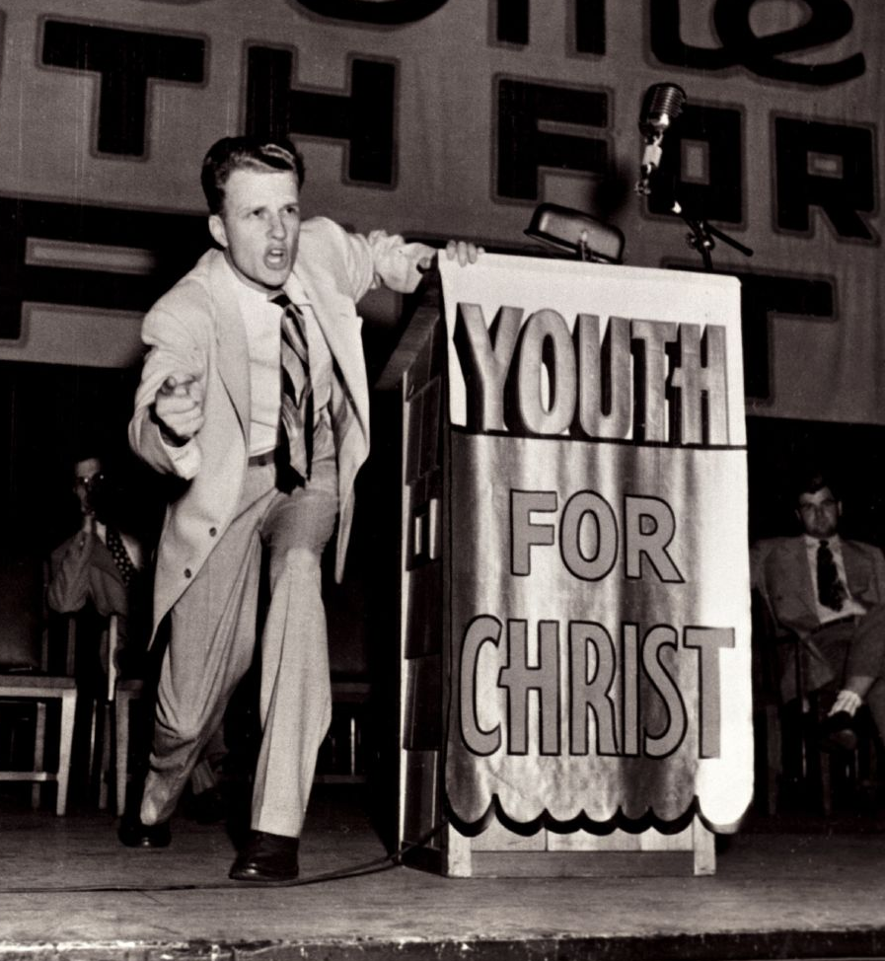
Johnny Devlin jiving with Mabel Howard, Wellington, 1959
Billy Graham preaching, 1949
Source: https://www.teara.govt.nz
Source: http://www.yfc.net

